Slide 1

Engineering Exploration Project Seminar on
Library Management System
Core branch: CSE with IoT, Cyber Security with Blockchain (CSE – 5)
MANASVI K – 160120749008
VYBHAVI BUKKA – 160120749021
MAHESH REDDY JAVVAJI – 160120749034
SAI MEDANSH T – 160120749046
SAI SATHVIK REDDY BONTU– 160120749047
Mentor : Dr. Kolla Morarjee Designation : Associate Professor

Slide 2
Contents
Topic Pg no.
Abstract……………………………………………….....
Background……………………………………………...
Problem Statement ……………………………………...
Motivation……………………………………………….
Formulation and Methodology…………………………..
Results & Discussion…………………………………….
Summary and Conclusion………………………………..
Future scope……………………………………………...
References………………………………………………..

Slide 3
Abstract
Manual process of keeping student records, book records, account details, managing employee is very difficult. There are various problems also faced by the student in library such as finding any particular book, tedious work of maintaining physical records etc.
To overcome these issues, we proposed the Library Management System(LMS). LMS will handle all the current issues faced by the students and by its admin personnel. This LMS project aims at developing a digitalized system to manage all the tasks of Library . It is totally built at administrative end.

Slide 4
Background
Library Management System is an application which refers to library systems to manage the library using a computerized system where he can perform enhanced tasks of the physical systems that exist today. Books and student maintenance modules are also included in this system which would keep track of the students using the library and also a detailed description about the books a library contains. With this computerized system there will be no loss of book record or member record which has been happening until now when a non computerized system is used. All these modules are able to help librarian to manage the library with more convenience and in a more efficient way as compared to library systems which are not computerized.

Slide 5
Problem Statement
File lost or damaged
When computerized system is not implemented file may be lost because of human or environment. Some times due to some human error there may be a loss of records.
Difficult to search record
There was always a difficulty in searching of records if the records are large in number .
Space and cost consuming
After the number of records become large the space for physical storage of file and records also increases .
The cost of storage also increases.
Some natural disaster like floods or fires may also damage the files.
It is also cost consuming to maintain such a huge data physically.

Slide 6
Motivation
The problems stated under the problem statement and our interest towards python programming has motivated us to create this project on Library Management System

Slide 7
System Design
admin login
borrowers
Remove book
Over due
password
encrypt
Librarian
Add book
id
manage
Search
Sign up
Sign in
Borrow details
Log out
by
Student
issue
name
ISBN
Search
return
fine
Search
location
author
publisher

Slide 8
Formulation and Methodology Admin
A
Admin Login
Enter correct username
Enter correct password
Edit books
Enter book detail to add it
Remove book using name or ISBN
Issue books
Allow student to borrow book using their account
Allow student to return books they borrowed
Fine student for late returns
Search books by different categories

Slide 9
Formulation and Methodology Admin
Issue report
View students to whom books have been issued
View students who have crossed the due date for returning books to contact them
Requests
View books requested by student
Logout
Logout so that others cannot use Admin account

Slide 10
Formulation Student
Student Sign in/Login
Borrow Books
Return books
View list of borrowed books

Slide 11
Formulation Student
Log out
Request for new books
Search books by different categories
Pay fine for late book returns

Slide 12
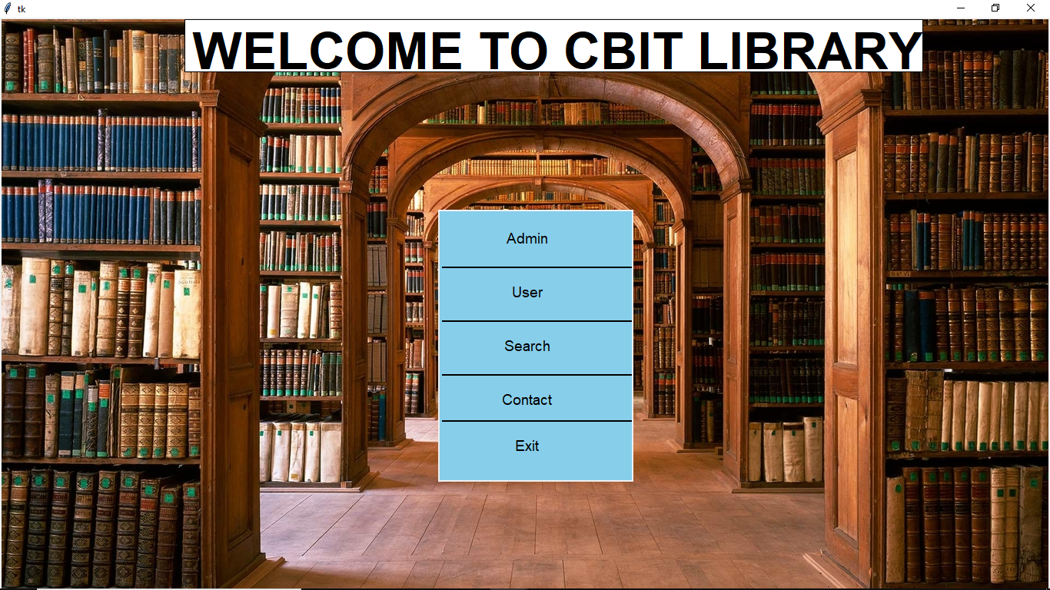
Result Main Page

Slide 13
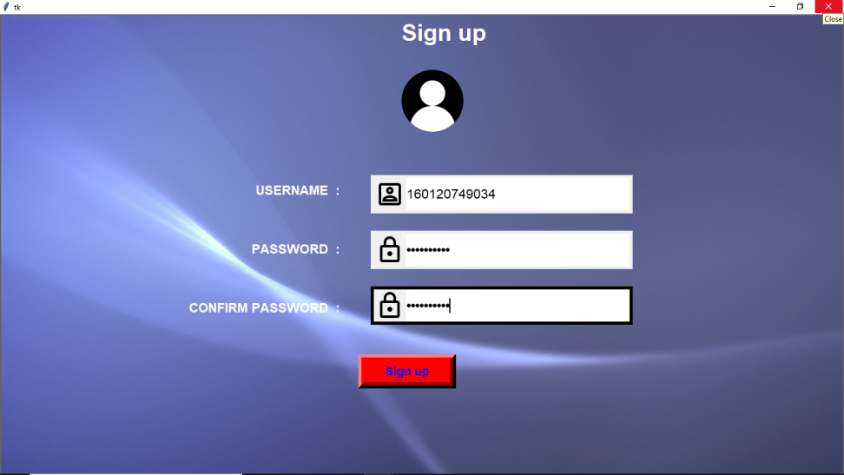
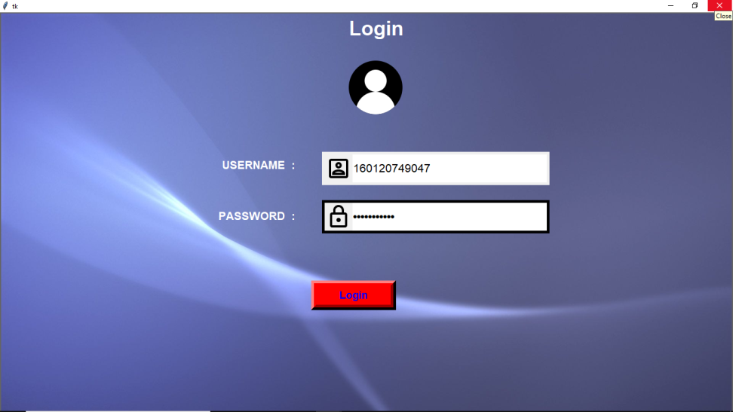
Result
Sign up
Sign in

Slide 14
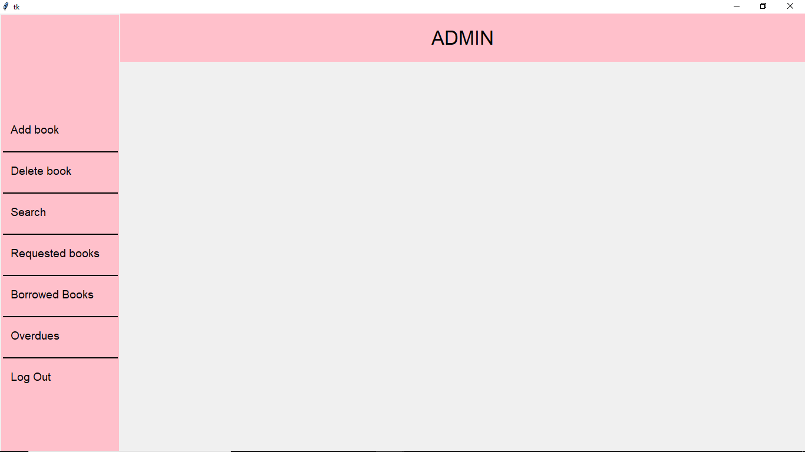
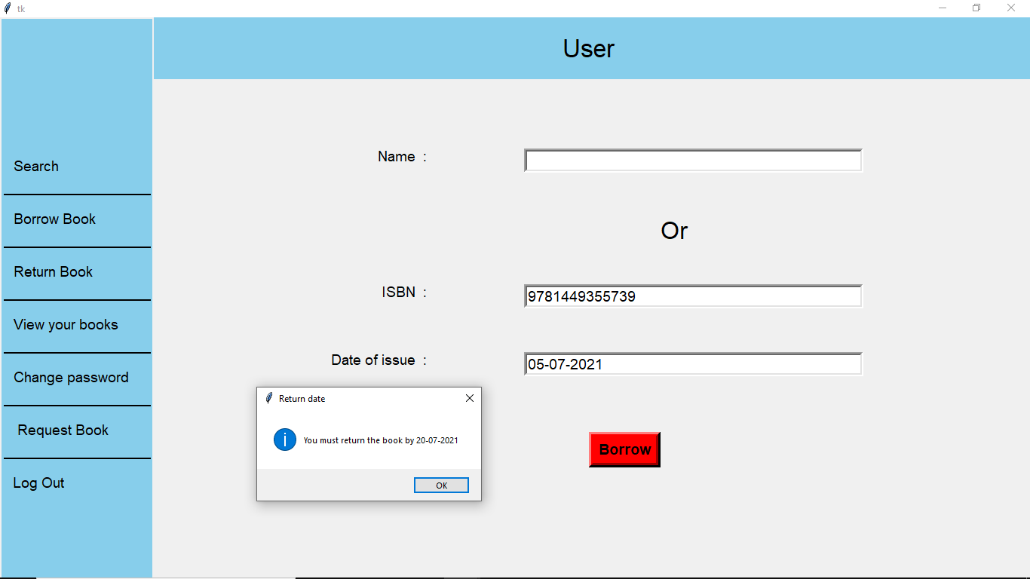
Result
Admin Window
Student window

Slide 15
Summary and Conclusion
The Library Management System has been developed to benefit the students as well as the staff of the library.
It automates and digitalizes many processes.
It secures every account by encrypting the passwords and this encryption is different for every user.
The main intention of this project is to reduce the manual work which is tedious and prone to errors.
This system has all the features that are required by a library.

Slide 16
Future Scope
There is a future scope of this facility that many more features such as online lectures video tutorials can be added by teachers as well as online assignments submission facility, a feature of group chat where students can discuss various issues of engineering can be added to this project thus making it more interactive more user friendly and project which fulfills each users need in the best way possible.
Also the security and authentication can be increased in the future by implementing fingerprint or facial recognition technologies. This system can even be taken online using HTML. Using DBMS for this will make the tasks even simpler.

Slide 17
References
https://stackoverflow.com/questions/4710067/how-to-delete-a-specific-line-in-a-file
https://www.geeksforgeeks.org/
https://www.tutorialspoint.com/python/index.htm
https://www.programiz.com/python-programming
https://stackoverflow.com/
Programming in python 3 text book by Mark Summerfield
Mark Lutz “Learning Python”, O’Reilly Media Inc., 5th Edition

